Slide 1
NATURAL LANGUAGE PROCESSING (NLP) DEMO
Presented By: Gamma 3 Group
Data Science and Artificial Intelligence(AI) Track
Women Techsters Fellowship 2021
5th July 2021

Slide 2

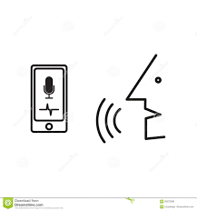
TKINTER VOICE ASSISTANT

Slide 3

The Team
Joy Kareko (Team Leader)
Ruth Waiharo
Anita Mburu
Esther Anagu
Lilian Adhiambo
Ajiboye Azeezat
Florence Wangeci
Juliet Nelly
Nelly Nyaga

Slide 4
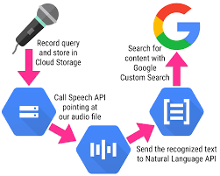
Problem
Virtual assistants powered by Artificial Intelligence have become a common feature of the big-data revolution.
Popular assistants available on mobile devices and PCs: Cortana, Google Assistant and Siri.
Their primary roles: to take neutral voice as the input.
Instrumental for children, people with disabilities and general users.
Gaps to address: build specific-tailor-made assistants, as the “one-size-fits-all” does not always apply.

Slide 5
Goals AND OBJECTIVES
GOALS
To find out how Search Engines with text to speech and speech to text functionalities work and then, build our very own search engine complete with a voice capturing capability which displays ability as well as a user interface.
BROAD OBJECTIVE
The objective is to have a voice assistant that outputs results for any search. The search engine will be enabled to recognize speech and text efficiently with regard to grammar and different accents.
SPECIFIC OBJECTIVES
Understand how NLP works.
Build a text to speech functionality.
Build a speech to text functionality.
Define and process Keywords using NLP python packages and APIs.
Visualize results through a GUI on Tkinter.

Slide 6
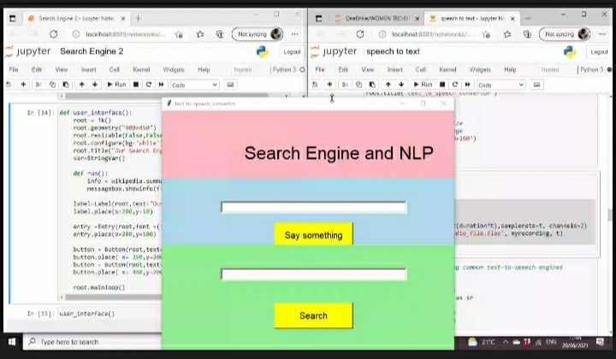
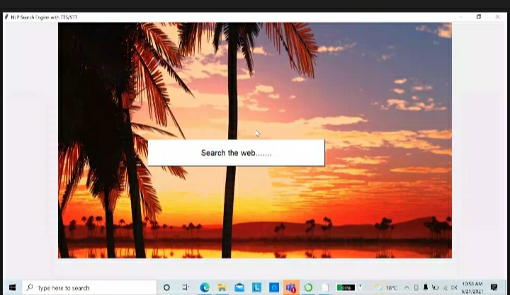
Prototype screenshots
Product 1
Product 2

Slide 7
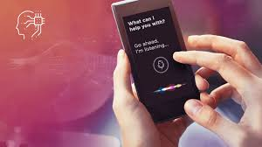
Showing how it works(Sample input and Output)
Speech: What is your name?
Response from Tkinter Assistant: "My name is Tkinter Voice Assistant“
Speech: Show me
Response from Tkinter Assistant: What do you want to see?
Speech: Pictures of cats Response from
Tkinter Assistant: Results for cats (Opens URL)

Slide 8
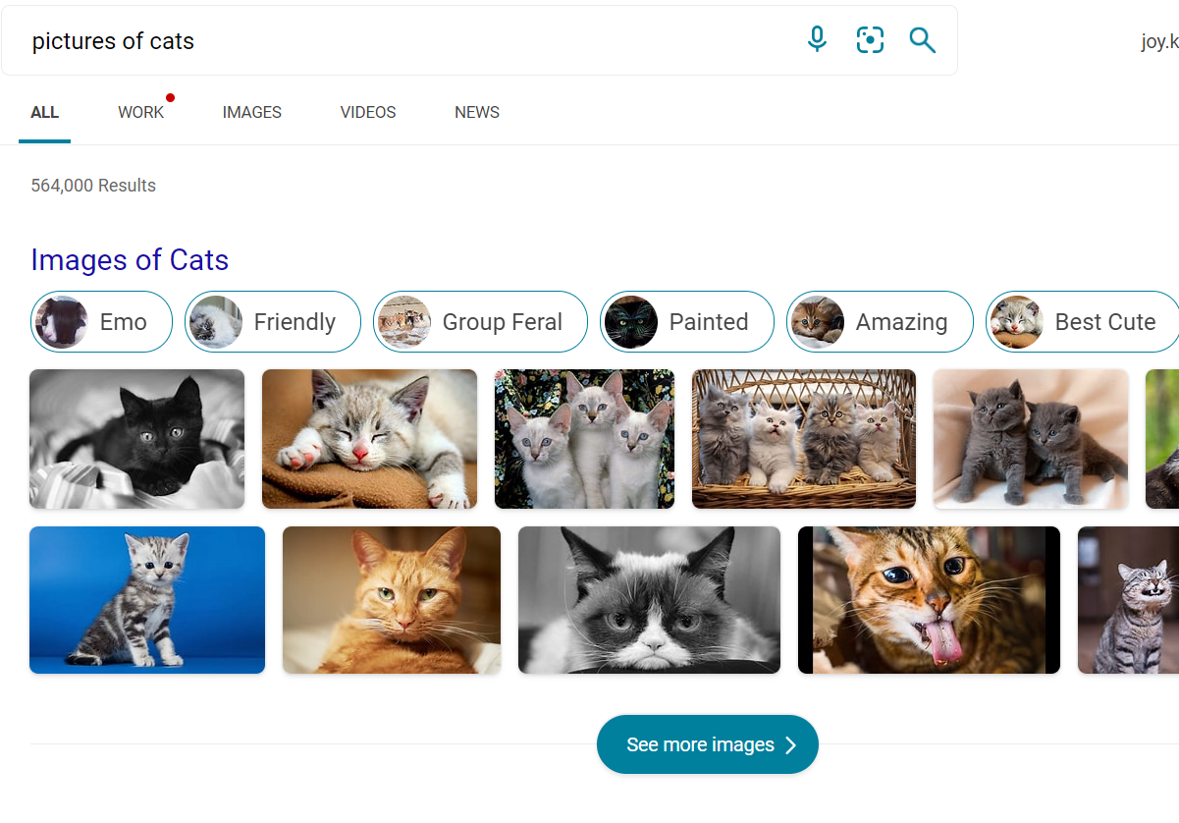
Showing how it works(Sample input and Output)

Slide 9
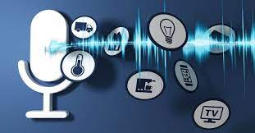
Tools
Jupyter notebook – Code.
NLP.
Python Libraries such as Tkinter, Speech recognition, Google Text to Speech among others.
Youtube Tutorials.
Data Science sites- geeks4geeks, Kaggle, Codeacademy, DataCamp, Analytics Vidhya.

Slide 10

Future product development ideas
Fully automate the product(use selenium with python for example for automation).
Make a website for example for use like Google.
Make a BOT.
Make an App.

Slide 11
References
https://www.kaggle.com/
https://www.analyticsvidhya.com/
https://www.datacamp.com/
https://www.youtube.com/watch?v=IWDC9vcBIFQ

